Slide 1
Clinical Approaches to IPF:
Diagnosis and Monitoring
Kevin R. Flaherty, MD, MS
Associate Professor
Pulmonary and Critical Care Medicine
University of Michigan Health System
Ann Arbor, Michigan

Slide 2
Faculty Disclosure
It is the policy of The France Foundation to ensure balance, independence, objectivity, and scientific rigor in all its sponsored educational activities. All faculty participating in this activity will disclose to the participants any significant financial interest or other relationship with manufacturer(s) of any commercial product(s)/device(s) and/or provider(s) of commercial services included in this educational activity. The intent of this disclosure is not to prevent a faculty member with a relevant financial or other relationship from participating in the activity, but rather to provide participants with information on which they can base their own judgments. The France Foundation has identified and resolved any and all faculty conflicts of interest prior to the release of this activity.
Kevin R. Flaherty, MD, has received grants/research support from ImmuneWorks, InterMune, and the NIH; he has served as a consultant for Boehringer Ingelheim, FibroGen, Genentech, Gilead, GlaxoSmithKline, ImmuneWorks, MedImmune, and Takeda; and he has received honoraria from Boehringer Ingelheim, Forest, GlaxoSmithKline, and Pfizer.

Slide 3
Learning Objectives
Explain the epidemiology of IPF and the importance of accurate and early diagnosis
Indicate how to accurately diagnose IPF in conjunction with a multidisciplinary team

Slide 4
Idiopathic Pulmonary Fibrosis
A specific form of chronic, progressive fibrosing interstitial pneumonia of unknown cause, occurring primarily in older adults, and limited to the lungs.
It is characterized by progressive worsening of dyspnea and lung function and is associated with a poor prognosis.
Raghu G, et al. Am J Respir Crit Care Med. 2011;183:788-824.

Slide 5
Epidemiology of IPF
Incidence
Prevalence
120
300
100
Male
250
Male
80
Female
200
Female
Per Hundred Thousand
Per Hundred Thousand
60
150
40
100
20
50
0
0
45-54
55-64
65-74
75+
45-54
55-64
65-74
75+
Estimated 34,000 New Patients
Per Year in the United States
Estimated 89,000 Current
Patients in the United States
Raghu G, et al. Am J Respir Crit Care Med. 2006;174:810-816.

Slide 6

Interstitial Lung Diseases - Difficulties
Diverse group of disorders (130+)
Similar symptoms, physiology, radiology
Difficult nomenclature
Limited, often toxic, treatments

Slide 7
Diffuse Parenchymal Lung Disease (DPLD)
DPLD of known cause, eg, drugs or association, eg, collagen vascular disease
Idiopathic interstitial pneumonias
Granulomatous DPLD, eg, sarcoidosis
Other forms of DPLD, eg, LAM, HX, etc
Idiopathic pulmonary fibrosis
IIP other than idiopathic pulmonary fibrosis
Desquamative interstitial pneumonia
Respiratory bronchiolitis interstitial lung disease
Acute interstitial pneumonia
Cryptogenic organizing pneumonia
Nonspecific interstitial pneumonia (provisional)
Lymphocytic interstitial pneumonia
ATS/ERS Consensus Statement. Am J Respir Crit Care Med. 2002;165:277-304.

Slide 8
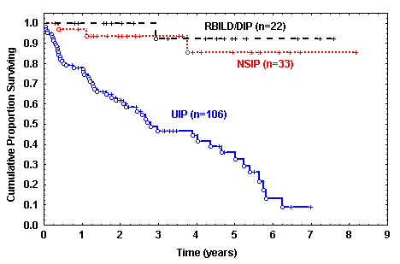
Diagnosis Matters!
IPF/UIP Confers a Poor Prognosis
Parameter | HR (95% CI)
IPF diagnosis | 28.46 (5.5, 147)
Age | 0.99 (0.95, 1.03)
Female sex | 0.31 (0.13, 0.72)
Smoker | 0.30 (0.13, 0.72)
Physio CRP | 1.06 (1.01, 1.11)
Onset Sx (yrs) | 1.02 (0.93, 1.12)
CT fib score ≥ 2 | 0.77 (0.29, 2.04)
Flaherty KR, et al. Eur Respir J. 2002;19:275-283.

Slide 9
Updated Consensus Statement
for Diagnosis of IPF
The diagnosis of IPF requires:
Exclusion of other known causes of interstitial lung disease
Presence of UIP pattern on HRCT (in patients without surgical biopsy)
A HRCT pattern of definite/possible UIP with a Surgical lung biopsy showing Definite/Probable UIP
The Major and Minor Criteria proposed in the
2000 ATS/ERS Consensus Statement were eliminated
Raghu G, et al. Am J Respir Crit Care Med. 2011;183:788-824.

Slide 10
Putting the Pattern in Context
Usual Interstitial
Pneumonia (UIP)
Nonspecific Interstitial
Pneumonia (NSIP)
Organizing
Pneumonia
Idiopathic Pulmonary
Fibrosis (IPF)
Idiopathic
COP/BOOP
Idiopathic
Connective Tissue Disease
Hypersensitivity Pneumonia
OP due to:
a very long list…
Rheumatoid Lung
Chronic Exposures
Hypersensitivity pneumonia
Occupational

Slide 11
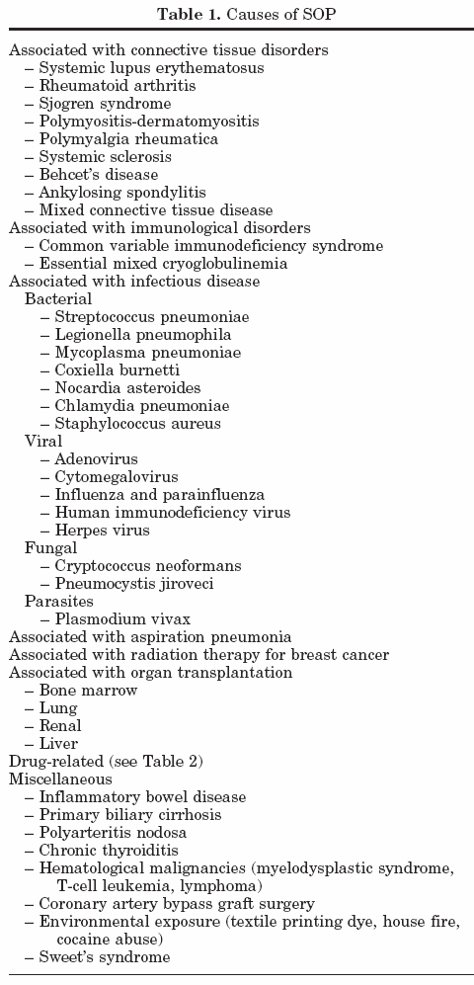
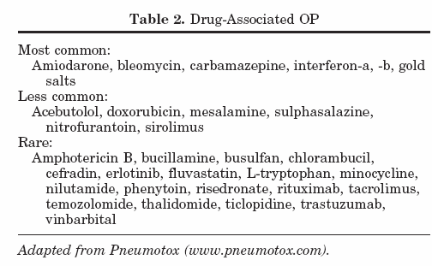
Causes of OP
Drakopanagiotakis F, et al. Am J Med Sci. 2008;335:34-39.

Slide 12
Interstitial Lung Disease
Diagnostic Team
Clinician
Radiologist
Pathologist
Multidisciplinary communication
is essential to an accurate diagnosis

Slide 13
Diagnostic “Tools”
Clinical
History & Physical, PFT, Lab
Raise suspicion that ILD is present
Identify a cause of the disease
  Infection
  Systemic Disorders
  Exposures
  Idiopathic

Slide 14
Pulmonary Function Tests
Restriction
  Reduced FVC and TLC
  Normal or increased FEV₁/FVC ratio
Impaired gas exchange
  Decreased DL_{CO}, PaO₂
  Desaturation on exercise oximetry
  Increased A-aPO₂ gradient
Normal PFTs do not exclude ILD
  Emphysema + Interstitial Lung Disease

Slide 15
Diagnostic “Tools”
Radiographic
CXR, HRCT
HRCT Features
Ground glass attenuation
Honeycombing/cysts
Lines/Reticular thickening
Consolidation
Nodules
Decreased lung attenuation
HRCT Distribution
Upper
Lower
Central
Peripheral
Diffuse/Bilateral

Slide 16
High Resolution
Computed Tomography
Allows detailed evaluation of the lung parenchyma
Technique
  Does NOT use contrast
  Thin collimation
    HRCT, approximately 1 mm slice thickness
    Conventional CT, approximately 10 mm
  Reconstruction with specific windows
  Inspiration, expiration, and prone images

Slide 17
HRCT Criteria for UIP Pattern
UIP Pattern (All 4 Features) | Possible UIP (All 3 Features) | Inconsistent with UIP (any)
Subpleural basal predominance Reticular abnormality Honeycombing with/without traction bronchiectasis Absence of features listed as inconsistent with UIP (column three) | Subpleural, basal predominance Reticular abnormality Absence of features listed as inconsistent with UIP (column three) | Upper or mid-lung predominance Peribronchovascular predominance Extensive ground glass abnormality (extent > reticular abnormality) Profuse micronodules (bilateral, predominantly upper lobe) Discrete cysts (multiple, bilateral, away from areas of honeycombing) Diffuse mosaic attenuation/air-trapping (bilateral, in three or more lobes) Consolidation in bronchopulmonary segment(s)/lobe(s)
Raghu G, et al. Am J Respir Crit Care Med. 2011;183:788-824.

Slide 18
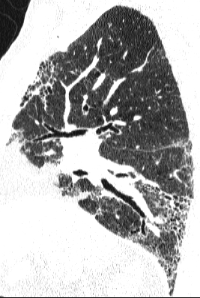
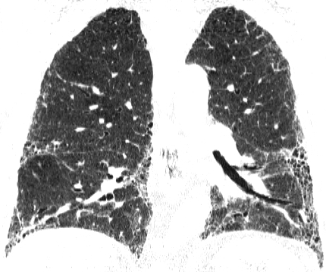
Usual Interstitial Pneumonia

Slide 19
UIP: Irregular Reticular Opacities
Courtesy of W. Richard Webb, MD.

Slide 20
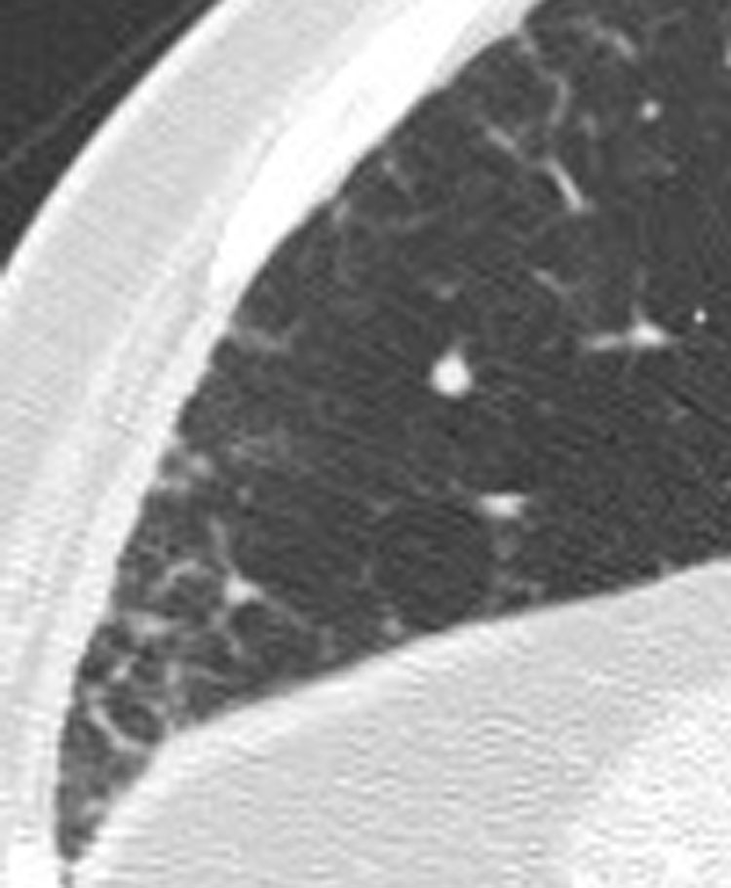
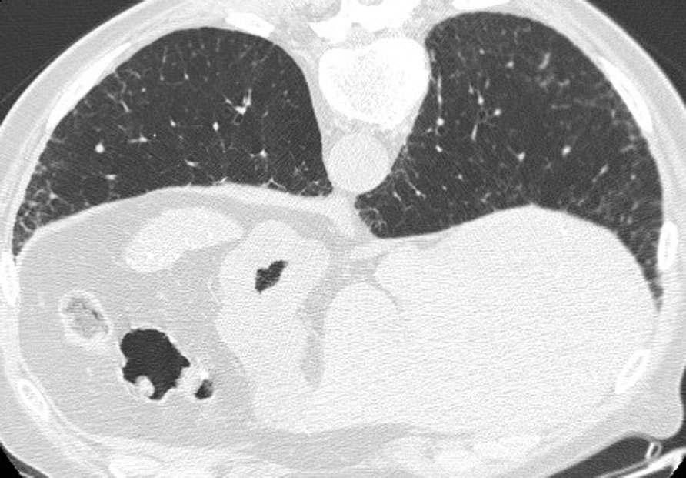
Early HRCT Findings in IPF
Courtesy of David A. Lynch, MD.
Notes:
Prone CT through the lung bases shows irregular septal thickening and reticular abnormality. No honeycombing is shown in this patient with early, biopsy proven UIP
This HRCT scan shows a reticular pattern with a predominantly subpleural distribution in a patient with mid- to late-stage IPF. Septal thickening and honeycombing are also seen.
Diagnosis
1 Min
Yes: 2 clicks

Slide 21
Diagnostic “Tools”
Clinical
History & Physical, PFT, Lab
Radiographic
CXR, HRCT
Histology
Bronchoscopy, Surgical Lung Biopsy

Slide 22
Risk Factors for Mortality
Associated with Lung Biopsy
Oxygen therapy pre-op¹
Acute exacerbation at time of biopsy²
Lower DL_{CO}³
Lower TLC (% predicted, morbidity increase)¹
Mechanical ventilation⁴
Immunosuppressed⁴
1. Kreider ME, et al. Ann Thorac Surg. 2007;83:1140-1145.
2. Park JH, et al. Eur J Cardiovasc Surg. 2007;31:1115-1119.
3. Utz JP, et al. Eur Respir J. 2001;17:175-179.
4. Lettieri CJ, et al. Chest. 2005;127:1600-1605.

Slide 23
IPF: ‘Supportive’ Treatment
Close monitoring of symptoms and pulmonary function
Treatment of comorbid illness
  ? GERD
  ? Pulmonary Hypertension
Exercise – pulmonary rehabilitation
Oxygen

Slide 24
Dyspnea Patterns Preceding IPF-related Death (n = 36)
Importance of Longitudinal Follow-Up
Dyspnea
Martinez FJ, et al. Ann Intern Med. 2005;142:963-967.

Slide 25
Decline in Forced Vital Capacity (FVC)
Increases Risk of Subsequent Mortality
1.0
FVC ↑ 10%
0.8
FVC < 10% Δ
FVC ↓ 10%
0.6
Survival Probability
0.4
0.2
0.0
0
2
4
6
8
Years
Flaherty K, et al. Am J Respir Crit Care Med. 2003;168:543-548.

Slide 26
Change in FVC
1156 randomized patients from IFN-γ1b trials
 | Visits (n) | Deaths (n) | HR Death (95% CI) | P value
FVC % pred
≤ -10 | 166 | 39 | 4.78 (3.12, 7.33) | < 0.001
-5 to -10 | 373 | 45 | 2.14 (1.43, 3.20) | < 0.001
> -5 | 1316 | 56
FVC, % pred
≤ 50 | 203 | 42 | 7.44 (3.28, 16.87) | < 0.001
51–65 | 691 | 65 | 4.09 (1.87, 8.98) | < 0.001
66–79 | 594 | 26 | 1.97 (0.85, 4.55) | 0.111
≥ 80 | 374 | 7
Du Bois RM, et al. Am J Resp Crit Care Med. 2011;184:1382-1389.
Notes:
Reliability – Stability of % predicted FVC btwn screen and baseline visit (-28 day to -1 day)
Criterion Validity – Relationship btwn FVC and DLCO, Aa, 6MWD, UCSD-SOBQ, SGRQ, SF36
Construct Validity – compare mean %pred FVC across subgroups presumed to have diff levels based on DLCO, Aa, 6MWD, UCSD-SOBQ, SGRQ, SF36
Responsiveness – Change in 24 wk FVC and changes in DLCO, Aa, 6MWD, UCSD-SOBQ, SGRQ, SF36 as well as death at 1 year
Distribution based MCID – included SEM (multiply estimated sd at base for all subjects by square root of one minus the estimated reliability coefficient. One SEM defined as MCID.
Effect size MCID – Divide difference in mean % predicted FVC at baseline and week 48 by sd of measure at baseline. Change in ES of 0.2 – 0.5 approximates MCID
Patient referencing – Defined by patient global rating of change in health status at 48 wks (much better, somewhat better, same, somewhat worse, much worse – 2nd and 4th felt MCID)
Criterion referencing – estimate diff in FVC btwn pts that did and did/not experience hospitalization, death in 48 wks)

Slide 27
Decline in Diffusing Capacity at 12 Months Increases Risk of Subsequent Mortality
100
Stable/Improved DL_{CO}
UIP (n = 21)
75
NSIP (n = 23)
Survival (%)
50
25
Decline in DL_{CO}
UIP (n = 20)
NSIP (n = 8)
0
0
12
24
36
48
60
72
Time (months)
Mortality was substantially higher in patients with a change in DL_{CO} of more than 15%
Latsi PI, et al. Am J Respir Crit Care Med. 2003;168:531-537.

Slide 28
Prognostic Indicators: Baseline DL_{CO} and Change in FVC Are Associated With a Poor Prognosis
 | Hazard Ratio | 95% CI | P-Value
Age | 1.027 | 0.992–1.064 | 0.134
Resting PaO₂ | 0.995 | 0.961–1.031 | 0.798
Initial FVC % predicted | 0.987 | 0.964–1.010 | 0.262
Male | 2.724 | 1.277–5.813 | 0.010
Initial DL_{CO} % predicted | 0.972 | 0.949–0.996 | 0.022
6-month change in FVC | 0.925 | 0.893–0.958 | < 0.001
NSIP diagnosis | 0.854 | 0.349–2.093 | 0.730
Jegal Y, et al. Am J Respir Crit Care Med. 2005;171:639-644.
Notes:
Prognostic Indicators: Baseline DL_{CO} and Change in FVC Are Associated With a Poor Prognosis
Jegal and colleagues evaluated the predictive value of physiologic parameters, including short-term changes in lung function, in 179 patients (131 with IPF; 48 with NSIP). After 6 months of follow-up, a multivariate analysis identified a number of factors that were predictive for poor prognosis. The 6-month change in FVC, the initial DL_{CO}, and male gender were all statistically significant predictors of survival. It is possible a combination of these factors (such as baseline DL_{co} and change in FVC) may be useful predictors of survival.
Jegal Y, Kim DS, Shim TS, et al. Physiology is a stronger predictor of survival than pathology in fibrotic interstitial pneumonia. Am J Respir Crit Care Med. 2005;171:639-644.

Slide 29
Prognosis by Change in PFT or CPI
Moderate or Severe Emphysema
 | 12 Month All patients (n = 144) |  | 12 Month No/Mild Emphy (n = 86) |  | 12 Month Mod/Sev Emphy (n = 32)
 | HR | P-value | HR | P-value | HR | P-value
FEV₁ ↓ 10% | 2.2 | 0.002 | 2.5 | 0.012 | 3.7 | 0.046
FVC ↓ 10% | 2.4 | < 0.001 | 2.8 | 0.005 | 2.1 | 0.154
DL_{CO} ↓ 15% | 2.3 | < 0.001 | 2.9 | 0.003 | 2.1 | 0.174
CPI ↑ 5 units | 2.1 | 0.004 | 3.6 | 0.001 | 2.4 | 0.135
Cox models adjusted for age, gender, smoking and baseline PFT
Schmidt SL, et al. Eur Respir J. 2011;38:176-183.

Slide 30
Baseline Desaturation on 6MWT
Predicts Decreased Survival in IPF
1.0
0.8
0.6
P = 0.0018
N = 83
Survival Probability
0.4
0.2
0.0
0
1
2
3
4
5
Years
Nondesaturators (SaO₂ > 88%, n = 39)
Desaturators (SaO₂ ≤ 88%, n = 44)
Lama VN, et al. Am J Respir Crit Care Med. 2003;168:1084-1090.
Notes:
Baseline Desaturation on 6MWT Predicts Decreased Survival in IPF
The usefulness of a 6-minute walk test (6MWT) goes beyond diagnosis and functional capacity. Exercise-induced hypoxia is also an index of the severity of interstitial lung disease and can define prognosis in terms of mortality. Lama and colleagues followed 83 consecutive patients from the University of Michigan Fibrotic Lung Disease database with biopsy-proven IPF with a 6MWT and found that patients with oxygen desaturation (SaO₂ ≤ 88% during the 6MWT) had significantly reduced survival when compared to those who did not desaturate (P = 0.0018). After adjusting for age, sex, smoking history, baseline, DL_{co} % predicted, FVC % predicted, resting saturation, and histologic diagnosis, IPF patients with a 6MWT desaturation had 4.2 times the risk of death when compared to the IPF patients who did not experience desaturation (P = 0.01). The relative 4-year survival rates for patients with IPF in this study were 69% for those who did not experience desaturation during the 6MWT and 35% for those who did experience desaturation.
Lama VN, Flaherty KR, Toews GB, et al. Prognostic value of desaturation during a 6-minute walk test in idiopathic interstitial pneumonia. Am J Respir Crit Care Med. 2003;168:1084-1090.

Slide 31
Baseline
Status
Six Month Test Results
that Suggest an Increased
Risk of Subsequent Mortality
15% decline in DL_{CO}
yes
SpO₂ ≤ 88%
during Baseline
6MWT
10% decline in FVC
15% decline in DL_{CO}
Decrease in walk distance of ≥ 200 feet
Increase in desaturation during 6MWT
no
Flaherty KR, et al. Am J Resp Crit Care Med. 2006;174:803-809.

Slide 32
Conclusions
New guidelines for IPF were released in 2011
Diagnosis of IPF requires a team approach
HRCT and sometimes histology are necessary for diagnosis, though lung biopsy has risks
Declining PFTs are associated with increased risk of subsequent mortality

