Slide 1
PFF Ambassador Program
Understanding
Pulmonary Fibrosis

Slide 2
Disclaimer
Medical Advice Disclaimer
The goal of this presentation is to create awareness, foster discussion and share medically accurate information about pulmonary fibrosis (PF).
This information is not intended to be a substitute for medical advice offered by a health care professional.
If you desire or need advice or referral information, please consult your health care provider or contact the PFF Patient Communication Center (PCC).
(Toll Free) 844-Talk-PFF or pcc@pulmonaryfibrosis.org

Slide 3
What is Pulmonary Fibrosis?

Slide 4
Pf is a family of dozens of different lung diseases
All Lung Diseases
Interstitial Lung Diseases (ILD)
Such as: COPD
Asthma
Cystic Fibrosis
Pulmonary Fibrosis (PF)

Slide 5
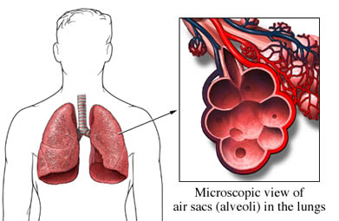
Interstitial Lung Diseases
The interstitial lung diseases (ILDs) are a group of diseases affecting the interstitium of the lungs
Inflammation and scar tissue are commonly seen

Slide 6

What is the interstitium?
CO₂
The interstitial lung diseases (ILDs) are a group of diseases affecting the interstitium of the lungs. Inflammation and scar tissue are commonly seen.

Slide 7
What is the interstitium?
CO₂
Scar tissue (also called “fibrosis”)

Slide 8
What is the interstitium?
CO₂
Scar tissue (also called “fibrosis”)

Slide 9
What Causes PF?

Slide 10
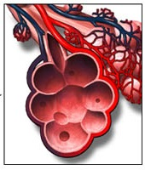
Why does PF happen?
  Injury to the cells in the lung
  Abnormal healing Response
  Inflammation and scarring

Slide 11
Both Genetic and Environmental factors can lead to “injury” and “abnormal healing” in the lung
Environmental Factors¹
Genetic Factors²
It is not known why some people develop PF
and others with similar risk factors do not

Slide 12
Sometimes we can identify the cause of PF
Medication side effects
Radiation therapy to the chest
Exposure to mold, birds, fibers, dusts, and other factors
Autoimmune diseases, such as rheumatoid
arthritis, scleroderma, Sjogren’s syndrome
In many cases, however, we cannot identify a
specific cause of PF

Slide 13

Sometimes we cannot identify the cause of PF
The word “idiopathic” means “the cause is unknown”
We don’t know the cause of Idiopathic Pulmonary Fibrosis (IPF)
There are many other types of PF for which the cause is also unknown
Even when we might know the “cause” of someone’s PF, we often still don’t understand why they were susceptible to that “cause” and others were not

Slide 14
Genetic Risk of PF and IPF
  If there is one other family member with IPF or pulmonary fibrosis (PF), the disease may be an inherited form
  Up to 20% of cases of IPF may be due to inherited forms of the disease
  Even when IPF is inherited, outward symptoms and underlying disease progression may be different between affected family members
  The Pulmonary Fibrosis Foundation (PFF) supports a genetics counseling program to help family members understand the disease and their risks of becoming sick with PF

Slide 15

Who Gets PF?
PF affects up to 200,000 people in the U.S.
Nearly 1 in 200 people age 65 and older carried a diagnosis of Idiopathic Pulmonary Fibrosis (IPF) in 2011 in the US
Approximately 40,000 people over 18 years of age are diagnosed with IPF each year
PF affects people of all ages, including children
IPF is more common in older adults

Slide 16
How is PF Diagnosed?

Slide 17
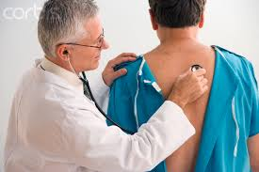
How is PF first identified?
PF can only be identified on a CAT scan of the chest or by examining lung tissue under a microscope (like after a lung biopsy)
The most common symptoms are:
  Breathlessness during exertion
  Bothersome “dry” cough
  Fatigue (low energy)
Sometimes PF is found on a CAT scan of the chest performed for other reasons or because a health care provider heard “crackles” in the lungs during a physical exam
Half of people with PF are diagnosed only after 2 or more years of breathlessness!

Slide 18
How do doctors diagnose PF?
A focused history and physical examination is important to help identify some of the “known causes” of PF
A High-Resolution CAT scan (HRCT) of the chest is a critical test to help diagnose PF correctly
  A regular CAT scan can identify the presence of PF
  An HRCT can help diagnose the type of PF
Blood tests are also important, since they can point your doctor to some of the “known causes” of PF
If a firm diagnosis cannot be reached after a history and physical, an HRCT, and blood tests, your doctors might consider performing a biopsy of the lung

Slide 19
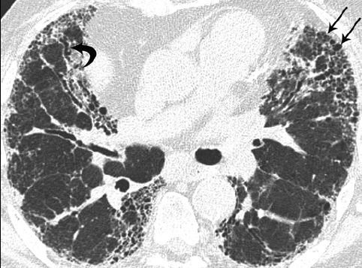
HRCT appearance of PF
SCAR TISSUE
HEALTHY
LUNG
TISSUE
Dense scarring
*Image courtesy of: Kevin O. Leslie, MD
.

Slide 20
What Happens After Diagnosis?

Slide 21

A Team of Health Professionals Will Support You
You will encounter a number of health professionals who will monitor your disease, help you manage your symptoms, and provide support for your journey.
Your team may include:
  Pulmonologist (lung doctor)
  Primary care physician
  Radiologist
  Rheumatologist
  Nutritionist/dietician
  Respiratory nurse
  Respiratory therapist
  Physical therapist

Slide 22
The Exact Course of Disease
Progression in PF Is Unpredictable
There is no known way to reverse the scar tissue that is already present in the lungs
Inflammation, on the other hand, can sometimes improve or even go away completely
No one can predict how your disease will change over time. Some people will get worse quickly, others will remain stable for some time, and other will improve
Based on an individual’s unique characteristics, your doctor might be able to give you a sense of best and worst case scenarios of what the future may hold for you

Slide 23
Progression of Symptoms
Varies From PERSON to PERSON
As PF progresses, symptoms will increase
Increased breathlessness with exertion, eventually even at rest
Dry cough may become more hacking, and may include bouts of coughing that cannot be controlled
Many will require supplemental oxygen as the disease progresses. At first with exertion and/or sleep, but eventually even at rest

Slide 24



Disease Progression Requires Monitoring
Disease progression is unpredictable and requires frequent monitoring
Monitoring may include the following tests:
Lung
Function Tests
Spirometry to measure how much air can be held, and how quickly the patient can move air in and out of the lungs
Walking tests to see how far a patient can walk and the changes in oxygen levels during exertion
CT scans to monitor the progression of the scarring in the lungs
Exercise Tests
Lung Scans

Slide 25
What Treatment Options are Available for PF?

Slide 26
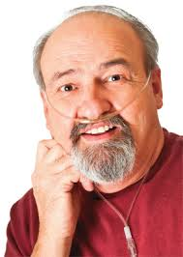
The most important treatments for PF
Smoking cessation
If your disease is of “known cause,” talk to your doctor about targeting the cause
Supplemental oxygen and pulmonary rehabilitation can help reduce symptoms

Slide 27
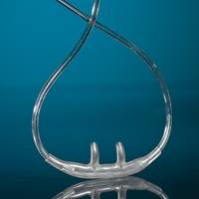
Supplemental Oxygen
Many people with PF experience low oxygen levels in their blood during exertion, sleep, or even at rest
Low blood oxygen levels are harmful!
  Puts strain on the heart and other organs
  Often leads to breathlessness and/or cough
  Limits activity level and quality-of-life

Slide 28

Supplemental Oxygen
Supplemental oxygen may be prescribed to maintain oxygen levels over 88-90% to help reduce breathlessness and symptoms
Some doctors recommend using a pulse oximeter to monitor oxygen levels at home during rest and exercise

Slide 29
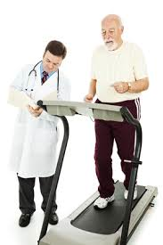
Pulmonary Rehabilitation
Pulmonary “rehab” is a structured exercise program that aims to improve your ability to function without extreme breathlessness
Each program varies, but here are some common features:
  Outpatient settings
  Lasts 6 to 12 weeks
  Attend 2-3 times/week
  Includes exercise on a stationary bike, treadmill, arm cycle and light weights

Slide 30

Pulmonary Rehabilitation
Studies have demonstrated improvements in both exercise capacity and health-related quality of life in patients with PF
You need a referral from your physician to start a pulmonary rehab program

Slide 31
Therapies FOR PF
In addition to oxygen and pulmonary rehabilitation, there are other therapies that may be available to help you manage your PF
  Corticosteroids, such as prednisone, can help some people
    Not recommended for chronic treatment of IPF
  Treatment of acid reflux (GERD), sleep apnea, cough, and other symptoms and conditions helps some people with PF
  Two new drugs were approved by the FDA in October 2014 for the treatment of IPF
Management of PF is individualized to each person. Please consult your physician for the course of treatment that is right for you

Slide 32

IPF-Specific Therapies
Pirfenidone (Esbriet®) and Nintedanib (Ofev®) are two
“anti-fibrotic” treatments that were approved by the FDA in October 2014 to treat IPF
Each of these drugs slows the progression of IPF over time
Neither drug improves the symptoms of IPF
These drugs may not be right for everyone. If you have IPF, talk to your doctor about these medications

Slide 33
Lung Transplantation
Lung transplantation is the surgical replacement of one or both lungs with one or two lungs from a donor
Lung transplantation helps about 1,000 people with PF each year in the U.S.
  Breathlessness and cough completely resolve
  No oxygen requirement
  Most people live longer with a transplant than without one

Slide 34
Lung Transplantation
There are also many risks and complications that people face after a lung transplant
Early referral is very important
There is no firm upper age limit

Slide 35

Research &
Clinical Trials in PF
Research into the causes of PF is ongoing around the world
There are also a number of clinical trials that are testing potential new medicines that may slow disease progression
You can find out more at:
  www.ClinicalTrials.gov
  www.PulmonaryFibrosis.org

Slide 36

Palliative Care
At the time of any serious diagnosis, such as PF, palliative care (or supportive care) should be offered alongside care focused on recovery and prolonging life, such as lung transplant evaluation and participation in research studies
Palliative care is appropriate for anyone who has a chronic or serious illness at any stage of the disease

Slide 37

What is Palliative Care?
Palliative care helps to address emotional, social and spiritual concerns as well as provide support for your caregivers
It often involves a multidisciplinary approach:
    Physicians, nurses, social workers, psychologists, other health care professionals
Helps address your advanced care plans, specifically allowing you to direct your wishes to be better prepared for the disease course
Published studies show that patients involved in palliative care live longer and have a better quality of life, by giving you better control of your symptoms and better control of your destiny. Overall, this gives you a better sense of control of your disease

Slide 38
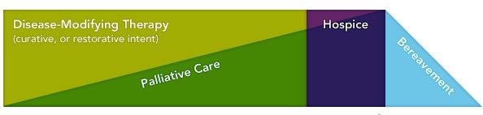
Hospice Care
Hospice care does everything palliative care does, except for actively treating the disease
Hospice care takes over for palliative care when a physician has certified the patient has 6 months to live
There is still a focus on quality of life and symptom management, psycho social and spiritual concerns and a multidisciplinary approach for the patient and their family
Can be provided at home, in a hospital, or in a nursing facility
Hospice care has also been shown to prolong life

Slide 39
What Support and Information is Available to Me?

Slide 40

PF Support groups
Many people experience anxiety, depression, concerns about disability and independence and work: You are not alone
PFF Support Groups
  www.pulmonaryfibrosis.org
    Click on “Life with PF” → “Support Groups”
Online Support Groups
  Inspire.com
  Rareconnect.org

Slide 41
PFF Resources
PFF Patient Communication Center
  Call 844-TalkPFF (844.825.5733) or email pcc@pulmonaryfibrosis.org with questions!
PFF website: www.pulmonaryfibrosis.org
  Life with PF section
    Information about PF, treatment options, and maintaining your health
    Find a PFF Care Center Network site or local ILD center
    Watch our archive of Disease Education Webinars or download educational materials
    Find a local PF support group or join our online support community on Inspire.com
Attend the PFF Summit 2015
  November 12-14th in Washington D.C.
  www.pffsummit.org for more information

Slide 42
Summary
PF is a family of serious lung diseases with scarring in the walls of the airsacs of the lungs
Each person with PF is different
  Treatment and prognosis will be different for each person
There are now two FDA approved therapies that slow the progression of IPF as well as therapies to help with symptom management in PF
  Be sure to talk with your physician about the course of treatment that is appropriate for you.
After your diagnosis, it is important to maintain a healthy lifestyle and find support through the Pulmonary Fibrosis Foundation

Slide 43
Thank you.

